Slide 1


THE ROLE OF STUDENT NURSE/ HEALTH WORKERS IN SUBSTANCE USE PREVENTION
Paper Presented
BY
OGUNGBEMIRO GEORGE TOSIN,
ASSISTANT SUPRITENDENT OF NARCOTICS (ASN I)
Drug Demand Reduction Unit,
NDLEA, Ibadan Zonal Command

Slide 2
INTRODUCTION
The National Drug Use Survey conducted by UNODC (2019) revealed that :
Estimated 14.3 million Nigerians and between the ages of 15 and 64 years had used psychoactive substances other than alcohol and tobacco;
Cannabis is the most common drug of use (10.6); million followed by Prescription Opioids (Tramadol, Codeine and Morphine 4.6 million)
Of the above figure, 2.4 million men and women had used cough syrups containing codeine
Drug use was most common among those between the ages of 25 and 39 years

Slide 3
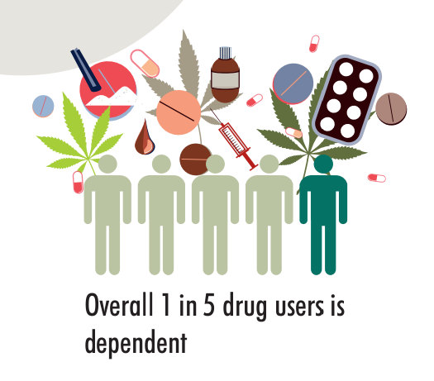
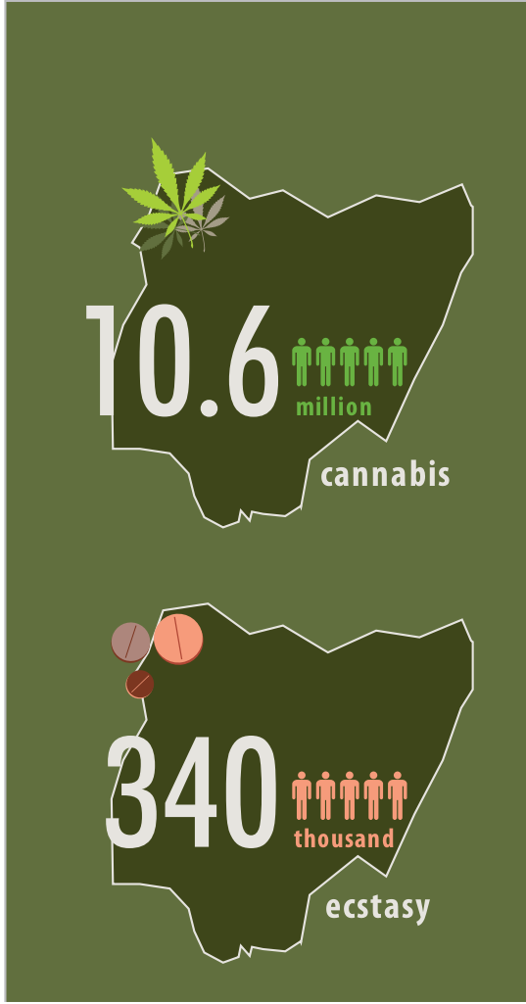
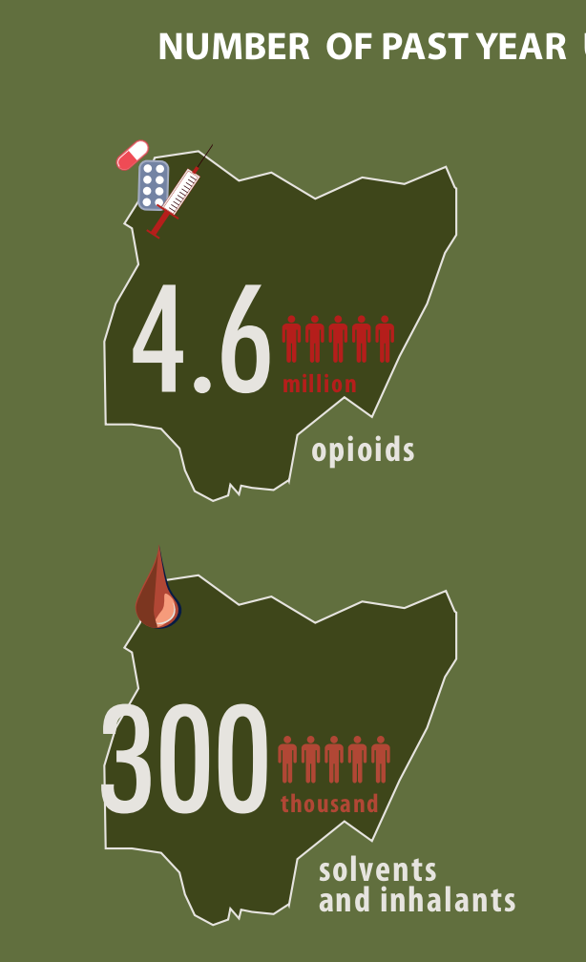
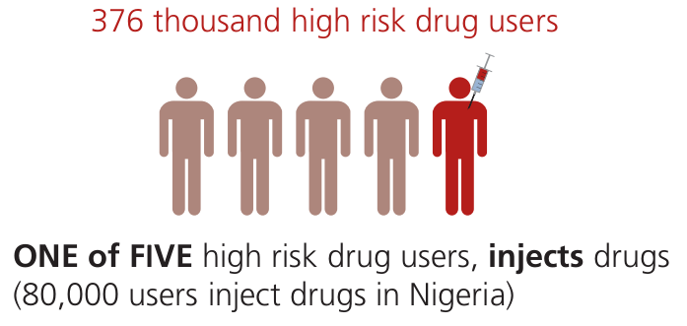
NIGERIA DRUG REPORT (UNODC, 2019)

Slide 4
NIGERIA DRUG REPORT (UNODC,2019)

Slide 5
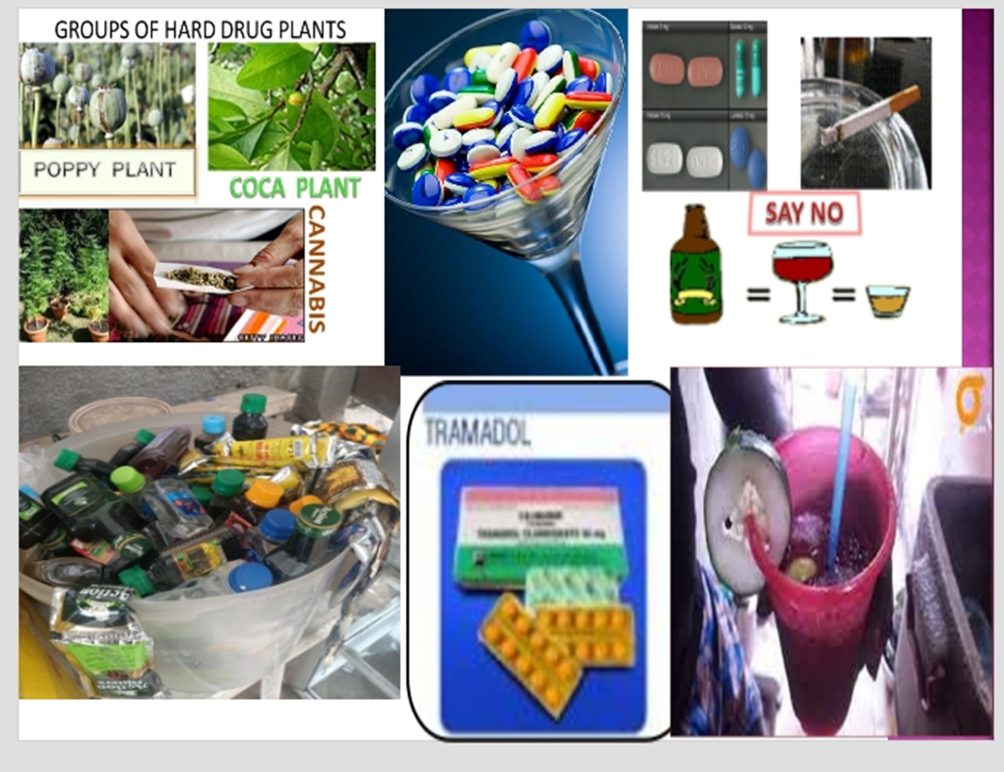
WHAT IS DRUG ABUSE?
Drug abuse is a phenomenon that occurs:
When the use of drugs is not medically necessary or not by prescription
When the use is legally prohibited (hard drugs)
When it is excessively used (Socially accepted drugs such as Alcohol, tobacco, caffeine etc.)

Slide 6
CLASSIFICATION OF DRUGS
This classification is according to the effects on the central nervous system (The Brain and Spinal Cord):
Depressants: Slow down the CNS
Stimulants: Stimulate the CNS
Hallucinogens: Distort the CNS
Unconventional Drugs

Slide 7
RISK FACTORS TO DRUG USE
Peer influence
Availability and accessibility of drugs
Academic pressure
Stress leads to frustration
Social Media

Slide 8
Impact of Substance Abuse
Health Effects in Nigeria:
Rising cases of mental health issues like psychosis.
Physical complications, e.g., liver and kidney damage.
Social Impact:
Drug abuse linked to increased crime rates, armed robbery, and cultism.
Broken homes and strained family relationships.

Slide 9
Impact of Substance Abuse
Economic Impact:
Loss of productivity in Nigeria's workforce.
Rising costs of rehabilitation and healthcare services.
Academic Effects:
Impaired Cognitive Function
Increased Absenteeism and Dropout Rates

Slide 10
METHAMPHETAMINE-ASSOCIATED PSYCHOSIS (MAP)
MAP is an acute state of transient psychosis which typically lasts less than 24 hours but can extend over a few days.
MAP is common with heavy and regular use of methamphetamine (including crystal methamphetamine).
People who use methamphetamine are more likely to experience psychosis than the general population.
One meta-analysis found that any use of amphetamines doubled the risk of psychosis, and an amphetamine use disorder tripled the risk. (National Drug and Alcohol Research Centre (NDARC))

Slide 11
SYMPTOMS OF METHAMPHETAMINE-ASSOCIATED PSYCHOSIS
Paranoia, feeling suspicious or persecutory ideation – Thinking people are out to get them, or (less commonly) thinking other people are reading their mind or stealing their thoughts, despite evidence to the contrary.
Hallucinations - Hearing, seeing, or smelling things that don’t exist.
Muddled thoughts or incoherent speech.
Depression or anxiety

Slide 12
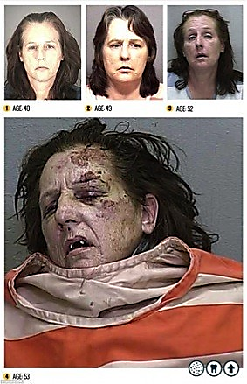
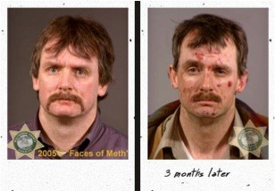
PROGRESSION OF EFFECT OF DRUG ABUSE

Slide 13
Why Prevention is Better Than Cure
Prevention is more cost-effective than addressing the aftermath (rehab and health costs).
Preventing drug abuse preserves Nigeria's youth population and workforce potential.
Leads to healthier communities and improved national development.

Slide 14
The Role of Student Nurses/Health Workers in Substance Use Prevention
Healthcare professionals, including student nurses and health workers, play a critical role in preventing substance abuse and promoting healthy behaviours in Nigeria.
Assessing patients' substance use
Providing education and counselling
Referring patients to treatment services
Advocating for policy changes

Slide 15
Why Student Nurses/Health Workers?
Student nurses and health workers are uniquely positioned to make a positive impact in substance use prevention in Nigeria due to their:
Close relationships with patients and communities
Opportunities for health education and promotion
Future roles as healthcare leader and advocate

Slide 16



Slide 17
Substance Use Prevention Strategies in Nigeria
Education and awareness
Self education and awareness.
Educating fellow students on campuses about substance abuse risks.
Organize sensitization walks and drug-free clubs.
Educating communities on the dangers of drugs.

Slide 18
Substance Use Prevention Strategies in Nigeria
Screening and assessment
Screening tools: screening tools like the CAGE questionnaire (Cutting down, Annoyance by criticism, Guilty feeling, and Eye-openers) and the AUDIT (Alcohol Use Disorders Identification Test) can help to identify individuals who may be at risk of substance abuse.
Clinical evaluation: including a physical examination, medical history, and laboratory tests
Laboratory tests: Laboratory tests, such as urine or blood tests, can help to detect the presence of substances and monitor the effectiveness of treatment.

Slide 19
Substance Use Prevention Strategies in Nigeria
Brief interventions
Motivational interviewing: a technique that helps individuals resolve ambivalence and mobilize their intrinsic motivation to change their behaviour.
Goal-setting: individuals setting specific, achievable goals for reducing or stopping their substance use.
Follow-up: To monitor individuals' progress, provide ongoing support, and adjust treatment plans as needed

Slide 20
Substance Use Prevention Strategies in Nigeria
Referral to treatment
Outpatient treatment: counselling, therapy, and support services is provided on an outpatient basis and may be suitable for individuals with mild to moderate substance use disorders.
Inpatient treatment: It provide 24-hour care and support in a hospital or residential setting suitable for individuals with severe substance use disorders or those who require medical detoxification.
Support groups: Support groups provide ongoing support and guidance for individuals in recovery.

Slide 21
Challenges and Barriers
Stigma and discrimination: Stigma and discrimination against individuals with substance use disorders can prevent them from seeking help and disclosing their substance use.
Limited resources and funding: Limited resources and funding for substance use prevention and treatment programs can hinder their effectiveness and accessibility.
Lack of training and education: A lack of training and education among healthcare professionals can limit their ability to provide effective substance use prevention and treatment services.

Slide 22

THEY NEED YOU

Slide 23

THEY NEED YOU

Slide 24
Opportunities and Solutions
Collaborations and partnerships
Innovative technologies and approaches
Research and Evaluation
Healthcare Professional Training and Education
Public Awareness and Education

Slide 25

National Drug Law Enforcement Agency

